Slide 1

Subject : Volunteering Platform .NETlammou
Fulfilled By:
Belhadj Abderrahmen Haithem
Belkahla Ikram
Ben Ali Hajer
JebaliaWiem
Mechmech Haythem
Tayeb Walid

Slide 2
PLAN
Study of the existing
Problematic
Solution
Fonctional Requirements
Functional Architecture
Conclusion

Slide 3
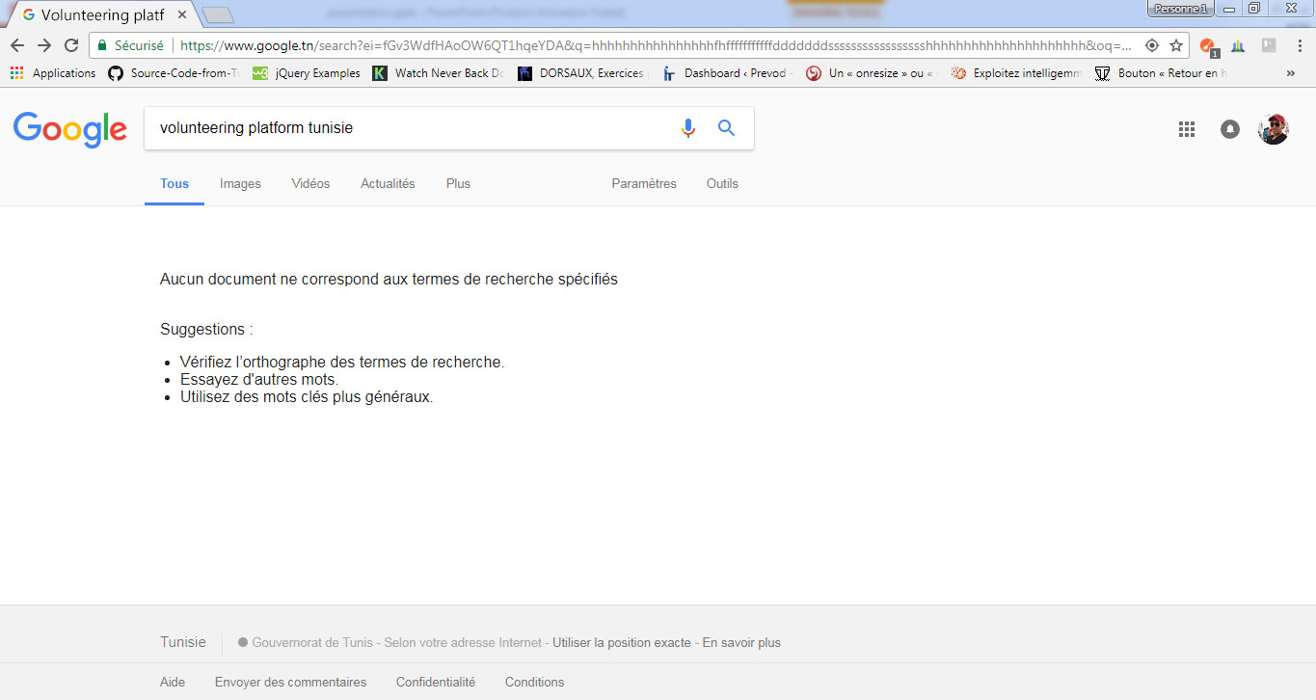
Study of the existing
3
Study of the existing
Problematic
Solution
Functional Requirements
Functional architecture
Conclusion

Slide 4

Problematic
Study of the existing
Problematic
Solution
Functional Requirements
Functional architecture
Conclusion

Slide 5

Solution : .NETlammou
Study of the existing
Problematic
Solution
Functional Requirements
Functional architecture
Conclusion

Slide 6
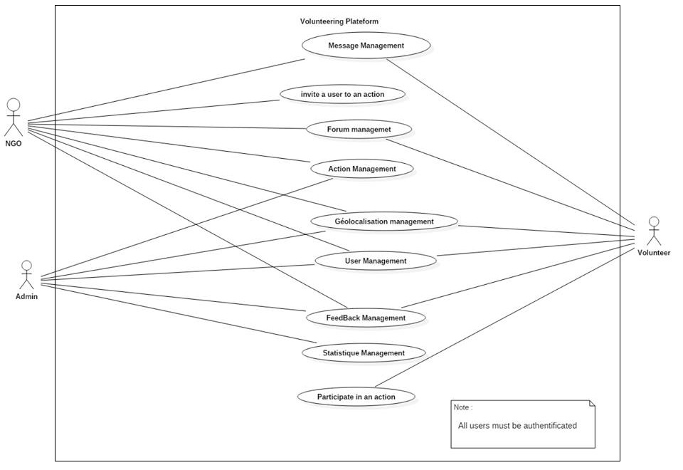
Functional Requirements
Study of the existing
Problematic
Solution
Functional Requirements
Functional architecture
Conclusion
Notes:
Omar b

Slide 7
User Management
Create profile
Update profile
Delete profile
Login
Invite a volunteer to an action.
View Profile.
View Potentiel Profiles
Study of the existing
Problematic
Solution
Functional Requirements
Functional architecture
Conclusion
Notes:
Omar b

Slide 8
Actions Management
Create an action
Update an action
Delete an action
View all the past actions
Generate Staistics
Search an action by date, type or localization
Notify volunteers with new actions
View actions with descriptions
Study of the existing
Problematic
Solution
Functional Requirements
Functional architecture
Conclusion
Notes:
Omar b

Slide 9
Geolocation
Management
Add
gelocation
Update
geolocation
View
geolocation
Delete
geolocation
Study of the existing
Problematic
Solution
Send a message
Functional Requirements
Functional architecture
Conclusion

Slide 10
Feedback
Management
Add a
comment
Update a
comment
Delete a
comment
Report a
comment
Treat a
Reported
comment
Rate past
actions
Study of the existing
Problematic
Solution
Functional Requirements
Functional architecture
Conclusion

Slide 11
Topic Management
Add a topic
Update a topic
Delete a topic
View discussions
View reported topics
11
Study of the existing
Problematic
Solution
Functional Requirements
Functional architecture
Conclusion

Slide 12
Messaging Management
Send a message
Delete a message
Send an email
Study of the existing
Problematic
Solution
Functional Requirements
Functional architecture
Conclusion

Slide 13
Global analysis class diagram
Study of the existing
Problematic
Solution
Functional Requirements
Functional architecture
Conclusion

Slide 14
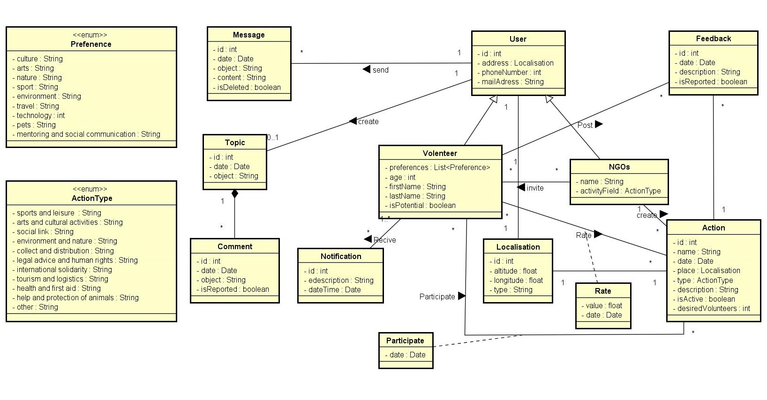
Study of the existing
Problematic
Solution
Functional Requirements
Functional architecture
Conclusion
Notes:
Omar b

Slide 15
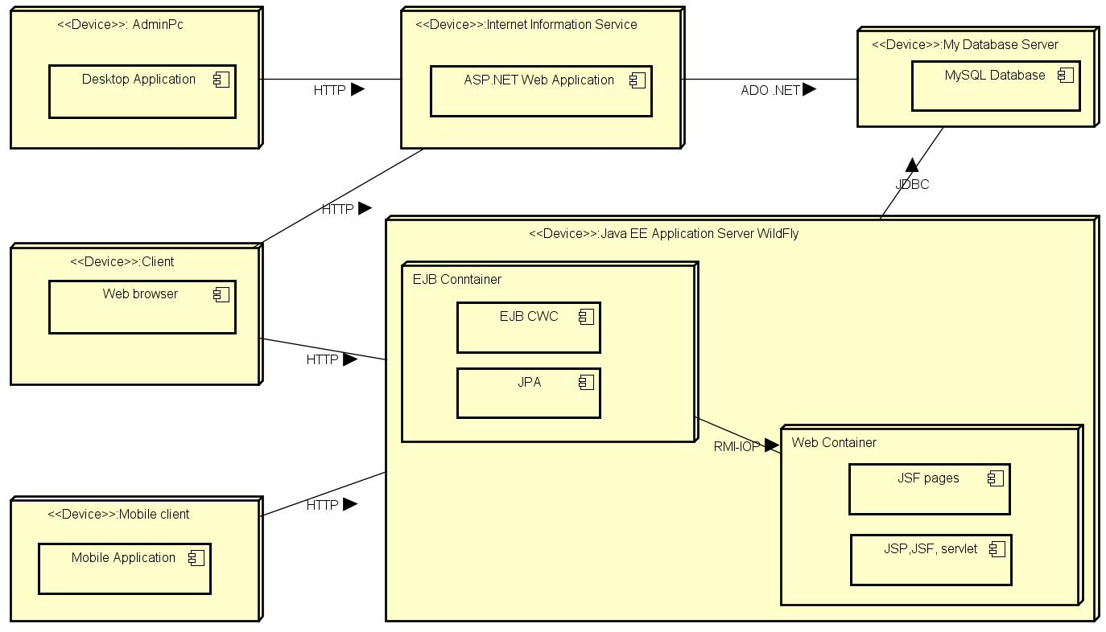
Functional architecture
Study of the existing
Problematic
Solution
Functional Requirements
Functional architecture
Conclusion
Notes:
Omar b

Slide 16

Conclusion
Study of the existing
Problematic
Solution
Functional Requirements
Functional architecture
Conclusion
Notes:
Omar b

Slide 17
Thank you for your attention.

